Slide 1
Michigan Neuroscience Institute – Resource Database

Slide 2

Overview
Why a shared resource database?
From poll to platform
Live MNI Resource Database demonstration
Factors to keep in mind & next steps
Points of discussion
Open Q&A

Slide 3



Why a Shared Resource Database?

Slide 4
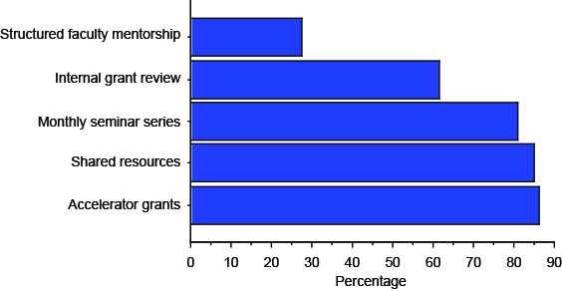
Listening to and Addressing Your Needs
What are potential benefits of becoming
an MNI faculty affiliate?

Slide 5
Outstanding Questions
What types of resources would be most useful in a shared database? What would you share?
What platform would be most accessible & effective?
How much detail should be present?
How and how often should the database be updated?

Slide 6
The Journey
Informational Interviews
HITS Engagement
Comparative Analyses
Platform Beta Testing
Pilot Group Feedback
Release to Entire MNI Community

Slide 7
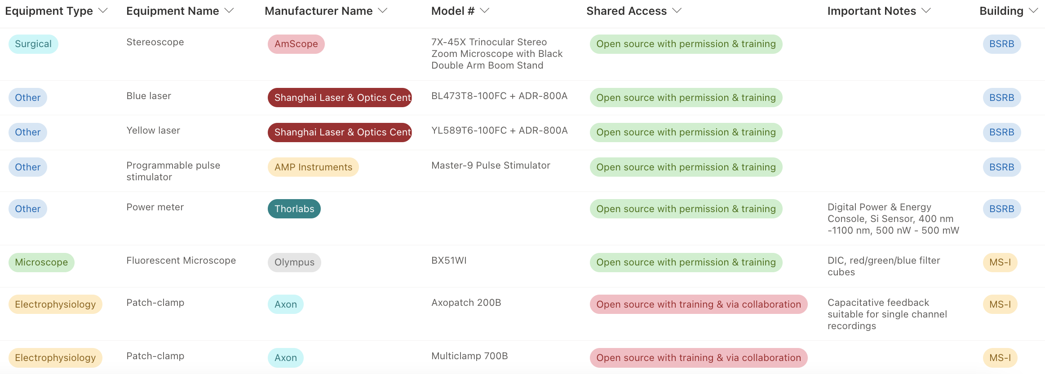
The MNI Resource Database

Slide 8
Keep in Mind & Look Ahead
Accessibility
non-HITS Microsoft 365
@umich & level-1 password for login
Nascent Living Database
Updated every 6mo-1yr
Open for feedback
Looking Ahead
Grants database
Expertise & protocol database
Adaptive elements

Slide 9
We Need Your Help!
Contribute
Copy, complete, and submit the excel sheet on the MNI website to Lucas Huffman (lucashu@umich.edu) for incorporation into the Database
Utilize
Explore the user guide on the MNI website for navigation and instructions
Give Feedback
More contributions and suggestions for improvement enhance usefulness
Note and communicate any thoughts or comments to Lucas Huffman
Most should have access, but if not reach out to request
Recruit lab techs/managers and senior graduate students to help
Only submit resources you are willing to share, we want more “yes” than “maybe” or “no” to promote collaboration

